Slide 1

Texting Attendance
UCSF Continuing Education Portal
Sample instruction slides for your audience.

Slide 2
To Pair Your Phone to Record Attendance
You must have an account in the UCSF CE Portal to claim credit.
This process must only be completed once.
1. Text your email address used in your profile to opt-in:
(833) 992 – 1812
2. Save the number to your contacts, e.g. UCSF CloudCME.
An activity code will be provided to claim credit during the session.

Slide 3
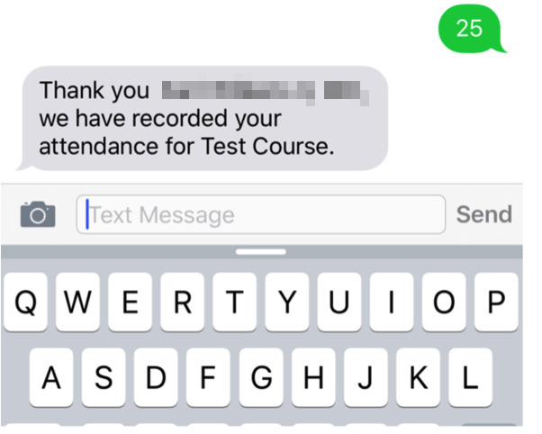
To Claim Credit for this Session
Text the following Activity ID to (833) 992-1812.
000000
On iOS, be sure you use SMS Text and not iMessage.

